Slide 1
Appeals Process
TIDE Training Module #6
Copyright © 2023 Cambium Assessment, Inc. All rights reserved.
Notes:
Welcome to the online training module for the Appeals Process in TIDE. In this training module we will walk through the process of creating appeals, viewing the status of appeals, and uploading appeals.

Slide 2
TIDE Training Modules
Activating Your Account and Navigating Through TIDE
Adding and Editing Users
Adding and Editing Students and Student Test Settings
Adding Students with a Temporary ID (for Screener only)
Managing Rosters
Appeals Process
Printing Test Tickets and Pre-ID Labels
Ordering Paper, Large Print, and Braille Tests and Tracking Shipments*
Entering Reason Not Tested Codes (for Summative administration only)
*Only applicable to states that elect to use the paper ordering module in TIDE
Notes:
The “Appeals Process” module is sixth in a series of online training modules on the TIDE system and its features. Visit the other training modules to learn about other features in TIDE, and check out the TIDE User Guide on your state’s portal for additional information about features in your state’s version of TIDE.
Please note that your state’s version of TIDE may be different from the images shown in this presentation.

Slide 3
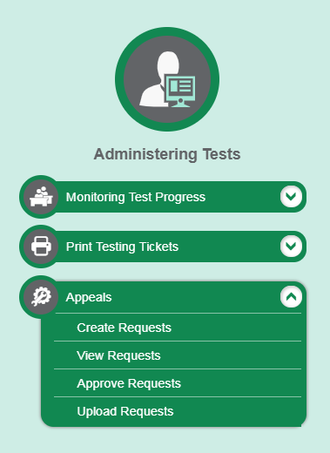
Appeals
Notes:
In the Administering Tests section of the TIDE dashboard, the Appeals task menu allows you to create appeals, view appeals, approve appeals, and upload appeals.
In the normal flow of a test opportunity, a student takes the test in the Test Delivery System and then submits it. Next, the Test Delivery System forwards the test for scoring, and the Reporting System reports the test scores.
Appeals are a way of interrupting this normal flow. Reasons for appeals can vary. For example, if a student’s test is paused, and then the test is automatically submitted before the student can complete it, an appeal must be created to reopen the student’s test. Not all users may create appeals and approve appeals. These tasks are restricted to certain user roles, as determined by your state. For information on your state’s particular permissions, policies, and procedures, please consult the Test Administration Manual.

Slide 4
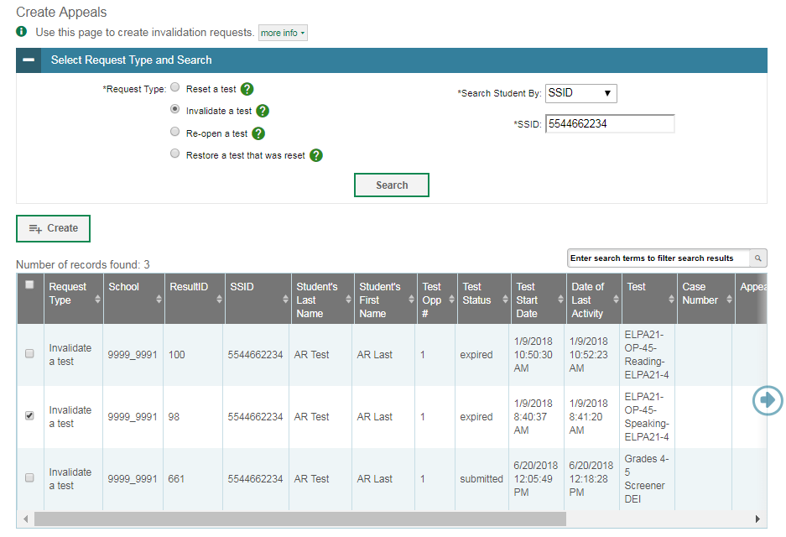
Create Appeals
Notes:
The Create Requests page is where you can create an appeal for a test. Note that not all user roles have access to this task.
The first step is to select the type of appeal you want to create. The TIDE User Guide lists the available appeal types and explains the implications of each.
Next, search for the test result for which you wish to create an appeal. From the drop-down lists and in the text field, enter your search criteria and click Search. TIDE will display the search results below.
Mark the checkbox next to each test result for which you wish to create an appeal and click Create. A window will pop up asking you to enter a reason for the appeal. To create the appeal, enter a reason and click Submit.

Slide 5
Status of Appeals
Appeal Status | Description of Status
Error Occurred | An error occurred while the appeal was being processed.
Pending Approval | Appeal is pending approval.
Processed | Appeal was successfully processed and the test opportunity has been updated.
Rejected | Another user rejected the appeal.
Rejected by System | Test Delivery System was unable to process the appeal.
Requires Resubmission | Appeal must be resubmitted.
Retracted | Originator retracted the appeal.
Submitted for Processing | Appeal submitted to Test Delivery System for processing.
Resolved | Appeal was resolved.
Notes:
After an appeal is created, its status can change throughout its life cycle. This table describes the possible statuses an appeal can have.

Slide 6
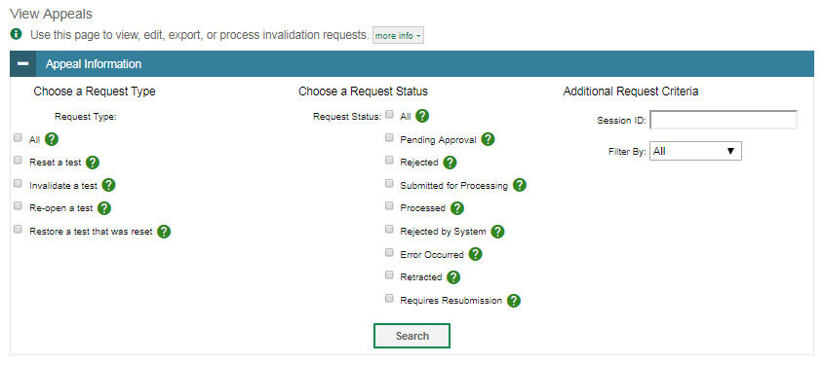
View Appeals
Notes:
You can review submitted appeals from the View Appeals page. Select an appeal type and status and enter additional search criteria as desired. Click Search to display appeals matching your criteria.
Appeals pending approval can also be found in the Approve Appeals page following a similar method, but appeal status is locked into “Pending Approval.”

Slide 7
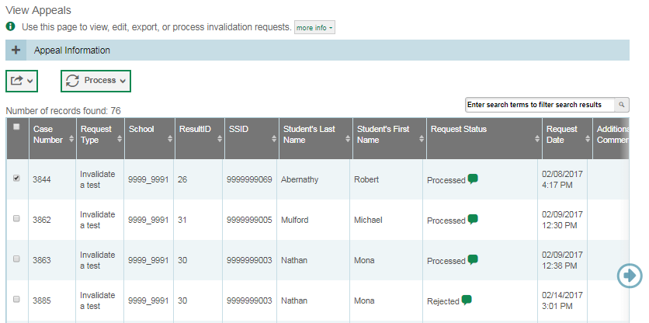
View Appeals (Continued)
Notes:
When you click Search, the search panel will automatically collapse, and your search results will appear below.
To view the approval and processing status of an appeal, click the green comment icon in the Status column.
To approve, reject, retract, or resubmit an appeal, mark the checkbox next to it, click Process, and then select the action you wish to perform.
Approving an appeal will update the test opportunities and results accordingly. Rejecting an appeal will continue the processing of test results as if the appeal were never submitted. Check your state’s policy to find out which roles have permission to approve appeals.

Slide 8
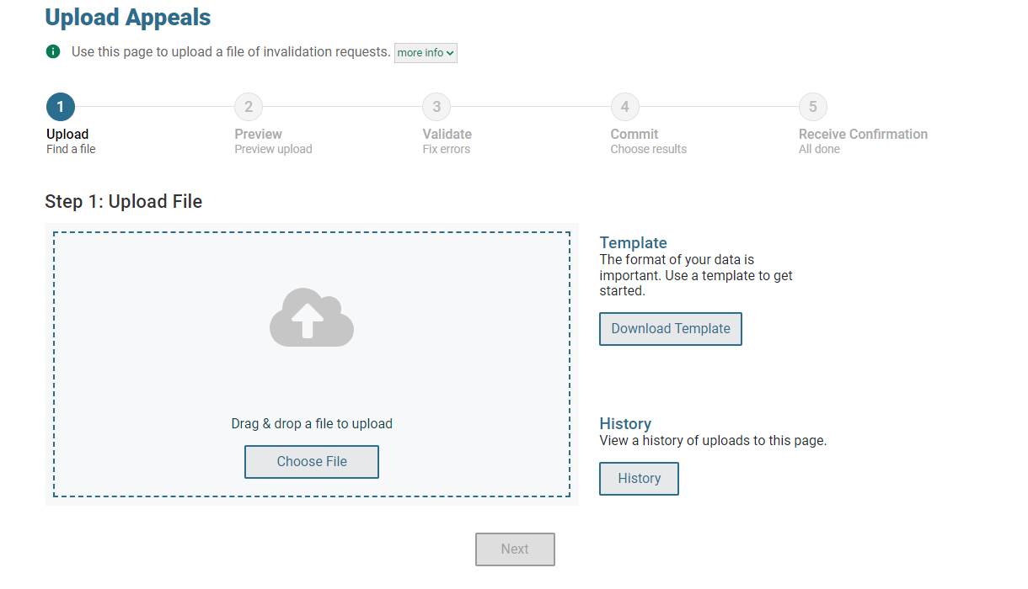
Upload Appeals
Notes:
Some users may also create new appeals in TIDE by using the Upload Appeals page to compose and upload a file in Excel or CSV format. This task is performed by following the same steps used to upload student test settings.

Slide 9
Thank You!
For additional information, consult your state portal, which contains:
Important announcements
TIDE User Guide
For further assistance, please consult your state’s Help Desk.
Notes:
Thank you for viewing this training module. For additional information, refer to your TIDE User Guide located on your state’s portal. You may also wish to view additional resources available on the portal.
If you have general questions or need further information, please consult your state’s Help Desk for assistance.

