Slide 1
Managing Rosters
TIDE Training Module #5
Copyright © 2023 Cambium Assessment, Inc. All rights reserved.
Notes:
Welcome to the online training module for Managing Rosters in TIDE. In this training module we will walk through the process for creating and editing rosters.
NOTE: Rosters are usually used to see scores for groups of students. If this does not or will not apply to your school or district’s administration of the ELPA21 assessment, you may disregard this module.

Slide 2
TIDE Training Modules
Activating Your Account and Navigating Through TIDE
Adding and Editing Users
Adding and Editing Students and Student Test Settings
Adding Students with a Temporary ID (for Screener only)
Managing Rosters
Appeals Process
Printing Test Tickets and Pre-ID Labels
Ordering Paper, Large Print, and Braille Tests and Tracking Shipments*
Entering Reason Not Tested Codes (for Summative administration only)
*Only applicable to states that elect to use the paper ordering module in TIDE
Notes:
The “Managing Rosters” module is fifth in a series of online training modules on the TIDE system and its features. Visit the other training modules to learn about other features in TIDE, and check out the TIDE User Guide on your state’s portal for additional information about features in your state’s version of TIDE.
Please note that your state’s version of TIDE may be different from the images shown in this presentation.

Slide 3
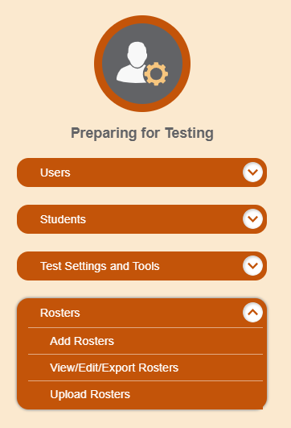
Rosters
Notes:
Rosters are groups of students associated with a teacher in a particular school. The Rosters task menu allows you to add rosters; view, edit, or export rosters; and upload rosters from an external file.
Once test scores are calculated, roster information is used to generate reports of how students in the roster performed as a group.

Slide 4
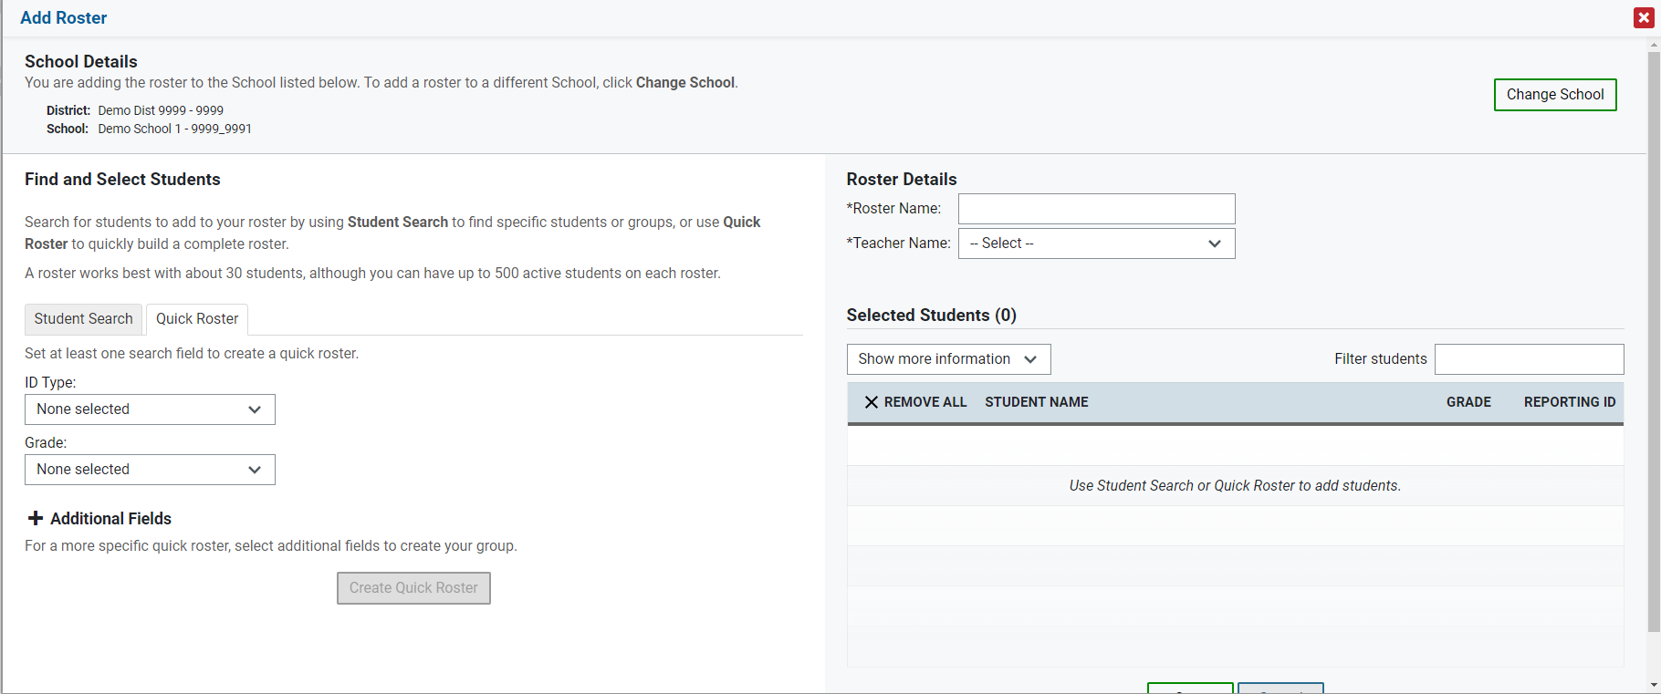
Add Roster
Notes:
You can manually create a roster on the Add Rosters page. Rosters are used by the Reporting System to group students’ assessment results for users who want categories below the school and district level. The use of Rosters is optional. To add a new roster, select the district and school to which the roster belongs.
Under Roster Details, enter a roster name and select the name of the teacher who should be associated with the roster.
Under Find and Select Students, the Quick Roster tab is selected by default. Select at least one search option to create a full roster of all students who match that option. To search for students with specific test settings enabled, expand the Additional Fields panel by clicking the plus sign. Select Create Quick Roster.
To edit the quick roster, select the X beside individual students or use the X Remove All option at the top of the table.
Select Save to create the roster and then Continue or Cancel to return to the Add Roster page.

Slide 5
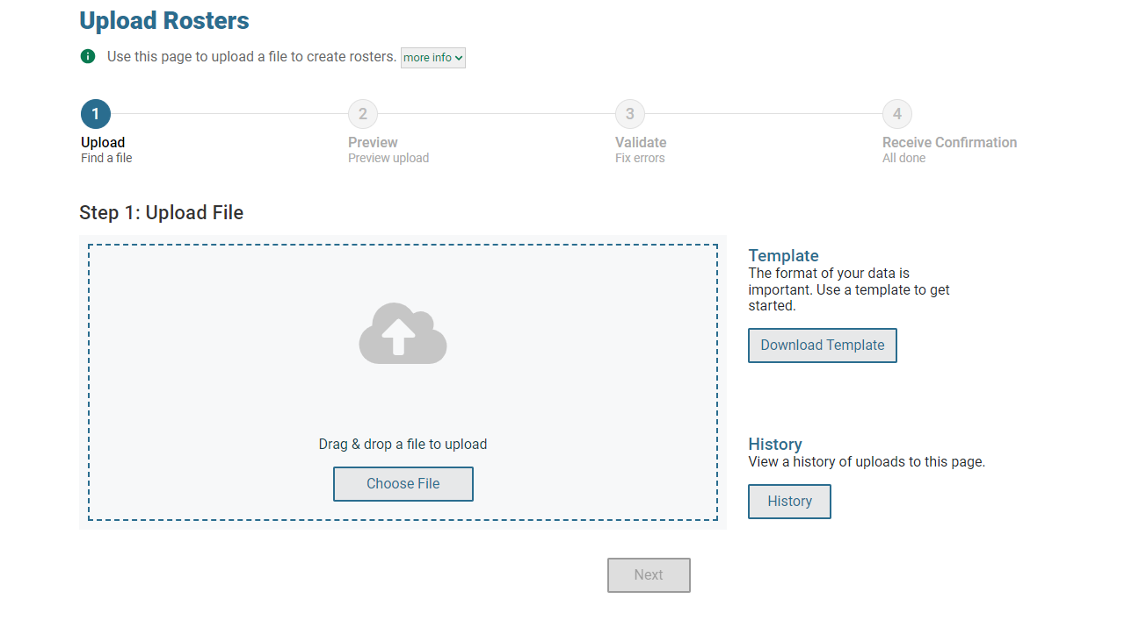
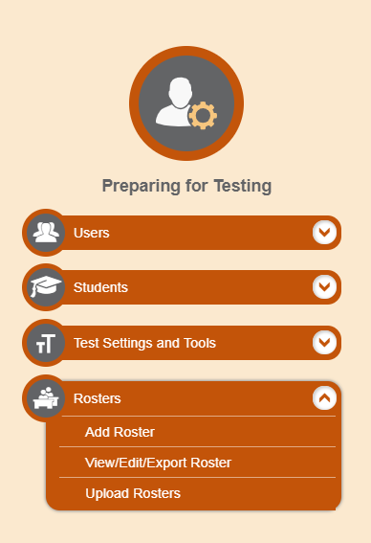
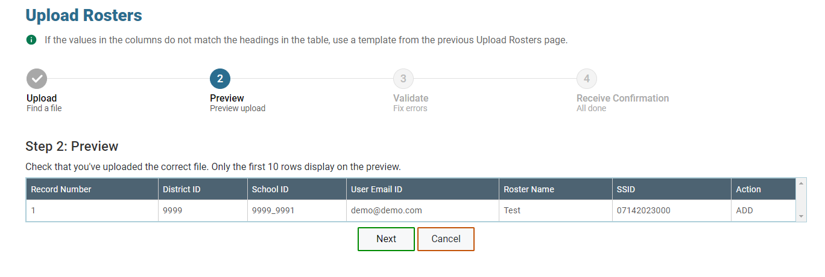
Upload Rosters
Notes:
A second way to add new rosters into TIDE is to use the Upload Rosters page to compose an upload file in Excel or CSV format and then upload that file. This method is easiest if you need to create many rosters, and you don’t want to add them one at a time.
The easiest way to compose an upload file is to download an available template, which you can do by clicking Download Templates and selecting either Excel or CSV.
Open the template using Excel or another program and enter the information for each student you wish to add to a roster. Save the file when you are finished. Detailed instructions for composing an upload file can be found in the TIDE User Guide. To see a list of files you have previously uploaded, click the blue plus sign to expand the Upload History panel.
When your file is ready to upload, return to TIDE, click Choose File, and select the file you just saved.
Click Next to upload the file. A file preview page will appear, allowing you to verify that you are uploading the correct file. If the preview is correct, click Next to continue.

Slide 6
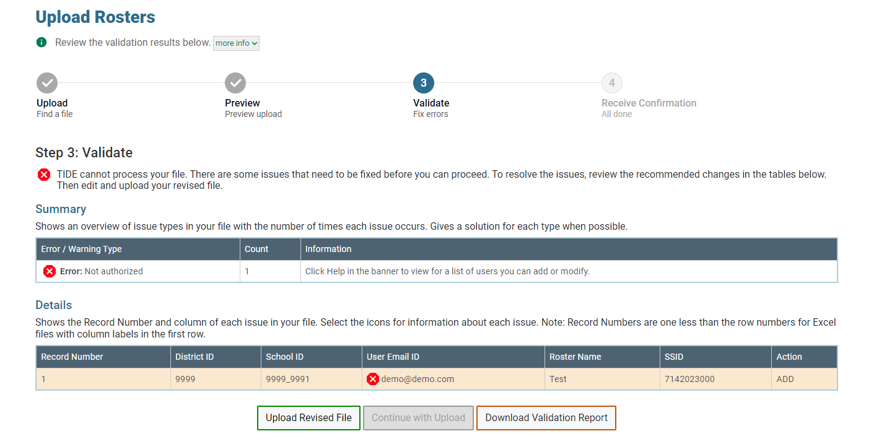
Upload Rosters (Continued)
Notes:
TIDE will validate the file and display any errors or warnings according to the legend on the page. Click the orange error icons and blue warning icons in the validation results to view the reason a field is invalid. If a record contains an error, that record will not be included in the upload. If a record contains a warning, that record will be uploaded, but the field with the warning will be invalid.
To complete the upload, click Continue with Upload.
To upload a different file, click Upload Revised File.
If your file contains a large number of records, TIDE will process it offline and send you a confirmation e-mail when complete. While TIDE is validating the file, do not press Cancel, as TIDE may have already started processing some of the records.
To view a PDF file listing the validation results for the upload file, click Download Validation Report..
When the upload is complete, a confirmation page will appear with a message that summarizes how many records were committed and how many were excluded.

Slide 7
View/Edit/Export Rosters
Notes:
The View/Edit/Export Rosters page includes a form for setting selection criteria to retrieve rosters. After selecting your criteria, click Search to display a list of matching rosters.
Print or delete rosters from TIDE by selecting the desired rosters and clicking the Print or Delete button above the search results.
Click the pencil icon next to a roster to view or edit its details. The Edit Roster form will appear. This form is similar to the form used to add rosters, and you may edit the roster name, teacher name, and students in the roster in the same way you would for a new roster.

Slide 8
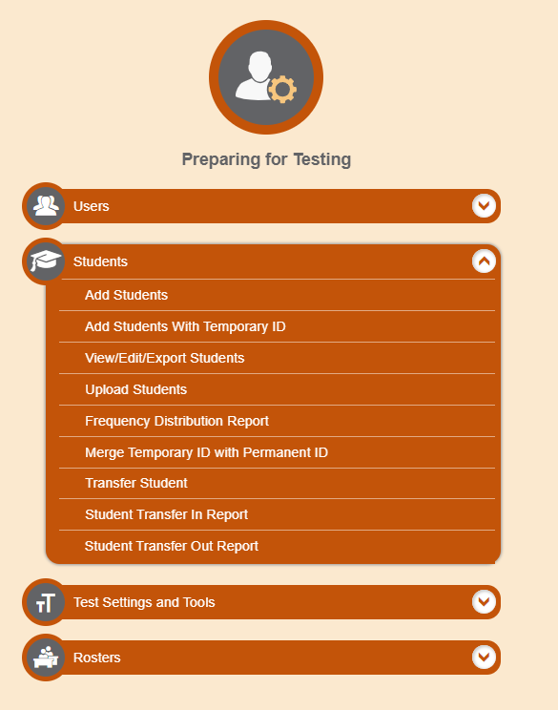
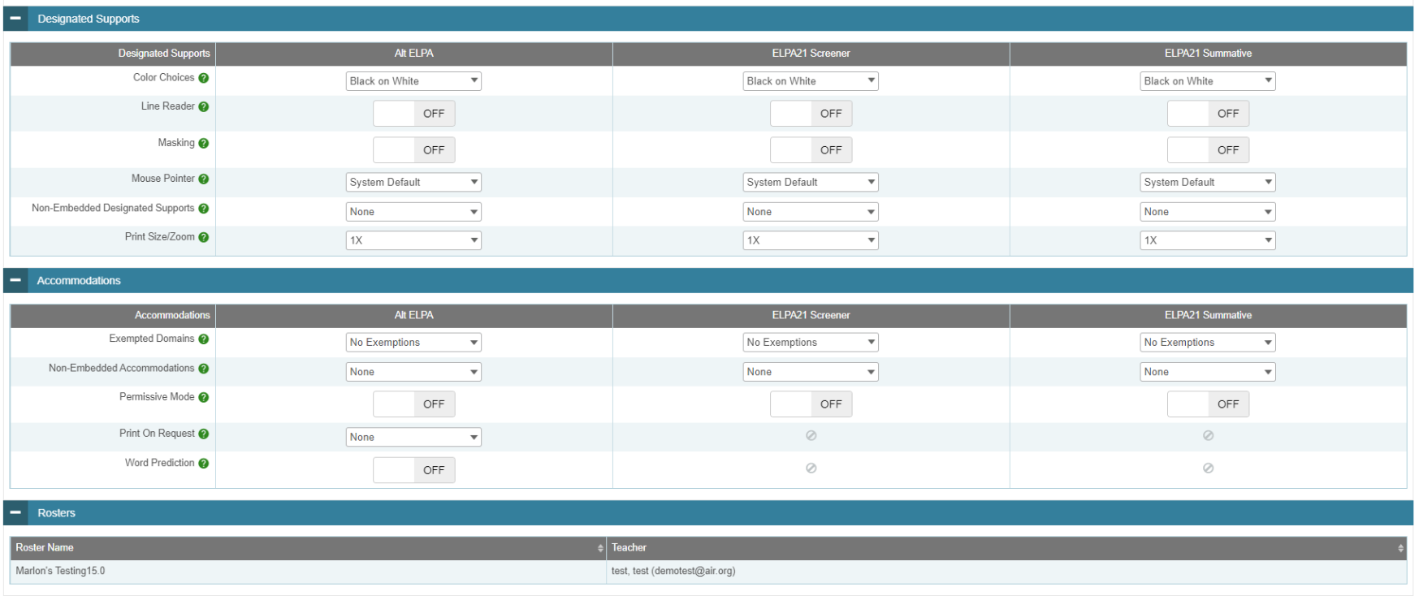
Student Roster Membership
Notes:
The View/Edit Student page displays the rosters to which a student belongs. This makes it easier for district/school personnel to verify that a student has been added to all necessary rosters.

Slide 9
Thank You!
For additional information, consult your state portal, which contains:
Important announcements
TIDE User Guide
For further assistance, please consult your state’s Help Desk.
Notes:
Thank you for viewing this training module. For additional information, refer to your TIDE User Guide located on your state’s portal. You may also wish to view additional resources available on the portal.
If you have general questions or need further information, please consult your state’s Help Desk for assistance.

