Slide 1
Adding and Editing Students and Student Test Settings
TIDE Training Module #3
Copyright © 2023 Cambium Assessment, Inc. All rights reserved.
Notes:
Welcome to the online training module for Adding and Editing Students and Student Test Settings in TIDE. In this training module we will walk through the process for adding and editing students as well as how to add and edit test settings for students, either individually or for a large group.

Slide 2
TIDE Training Modules
Activating your Account and Navigating through TIDE
Adding and Editing users
Adding and Editing Students and Student Test Settings
Adding Students with a Temporary ID (for Screener only)
Managing Rosters
Appeals Process
Printing Test Tickets and Pre-ID Labels
Ordering Paper, Large Print, and Braille Tests and Tracking Shipments*
Entering Reason Not Tested Codes (for Summative administration only)
*Only applicable to states that elect to use the paper ordering module in TIDE
Notes:
The “Adding and Editing Students and Student Test Settings” module is third in a series of online training modules on the TIDE system and its features. Visit the other training modules to learn about other features in TIDE, and check out the TIDE User Guide on your state’s portal for additional information about features in your state’s version of TIDE.
Please note that your state’s version of TIDE may be different from the images shown in this presentation.

Slide 3
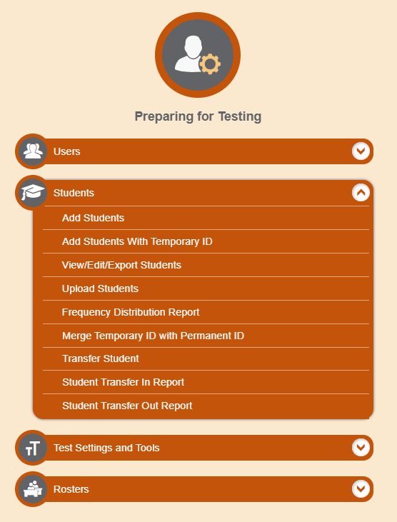
Students
Notes:
TIDE manages student information and keeps track of which assessments students are eligible to take. The Students task menu allows you to add students; view, edit, or export students; and upload student test settings.
Note that the tasks available under the Students task menu vary by state and may be different from what is shown here.

Slide 4
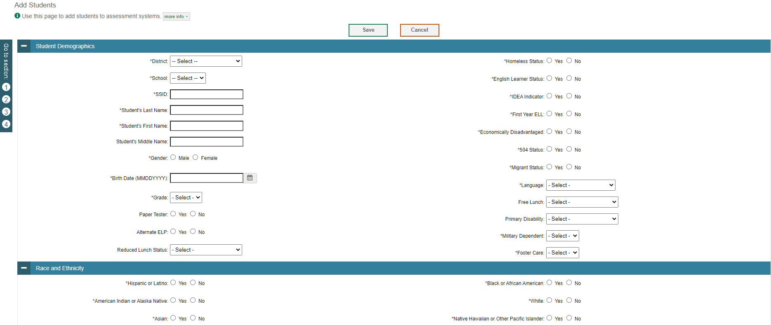
Add Students
Notes:
All students taking the assessment must be added to TIDE in advance of being administered a test. If your student is already listed with an SSID in TIDE, then they are ready to take the assessment. Otherwise, they must be added. This page contains four panels: Student Demographics, Race and Ethnicity, Accommodations, and Designated Supports.
Students who have permanent SSIDs may be added to TIDE from the Add Students page. To add a new student, first enter required information in the Student Demographics and Race and Ethnicity panels. The fields marked with an asterisk are mandatory.
Note that the student information fields vary by state and may be different from what is shown here.

Slide 5
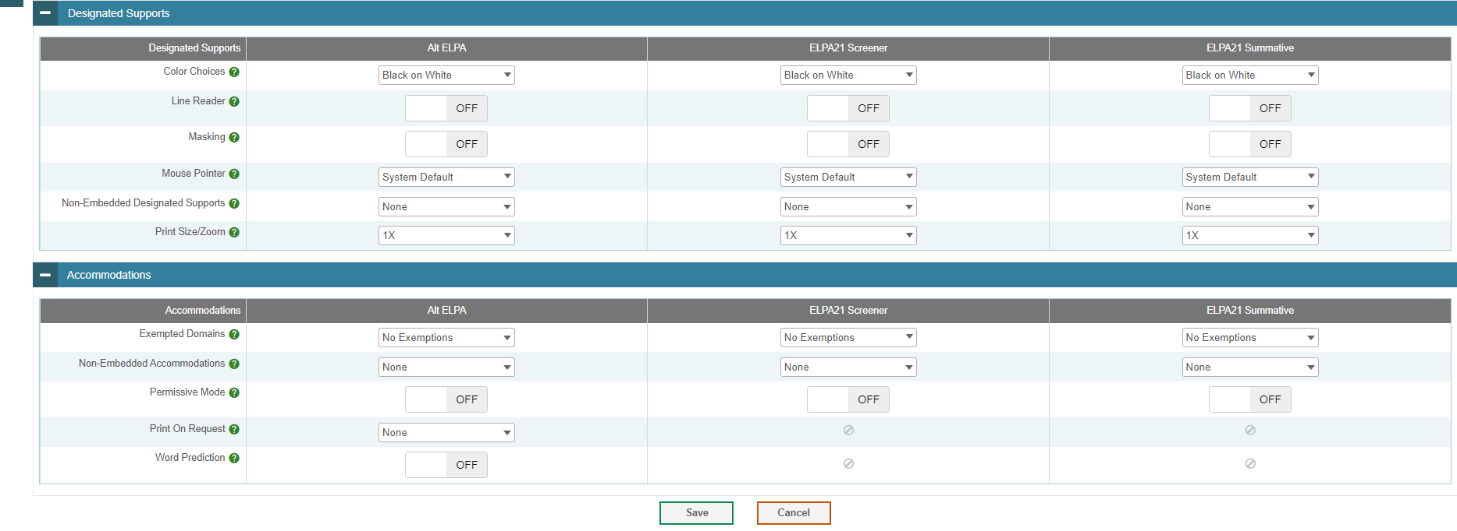
Add Students (Continued)
Notes:
Next, scroll down the page and, in the panels for Designated Supports and Accommodations, select the appropriate settings including domain exemptions, if any, using the drop-down lists. Click Save to add the student.

Slide 6
Domain Exemptions
Notes:
Note that students who require a domain exemption must have that domain exemption recorded in TIDE prior to testing. If no domain exemption appears in TIDE, then all domains will be scored for the student, even if no questions are answered.

Slide 7
View/Edit/Export Students
Notes:
Click View/Edit/Export Students to locate and edit student records. To search for all students who have Temporary IDs, select Temporary ID under “ID Type”, and then click Search. You will retrieve a list of all students with Temporary IDs.
To view students with permanent SSIDs, select “Select All” under “ID Type.” Then, set additional search criteria. The fields for District and School are mandatory and marked with an asterisk. Other criteria are optional, such as the SSID and the student’s name.
The students you can retrieve on this page are limited by your role’s scope. For example, if you are a district-level user, you can retrieve students enrolled within your district. If you are a building-level user, you can only retrieve students enrolled within your school.
Click Search to continue.

Slide 8
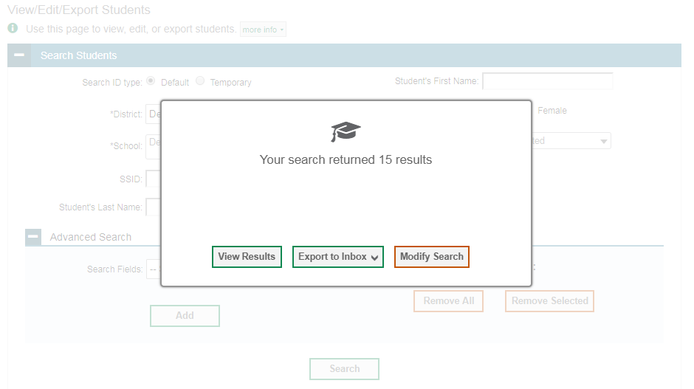
View/Edit/Export Students (Continued)
Notes:
After you click Search, you’ll see a message asking whether you would like to view the results of your search, export the list of students to your inbox, or modify your search criteria and try again. If you choose to export the results to your inbox, you will receive an email when the file is ready for you to download.

Slide 9
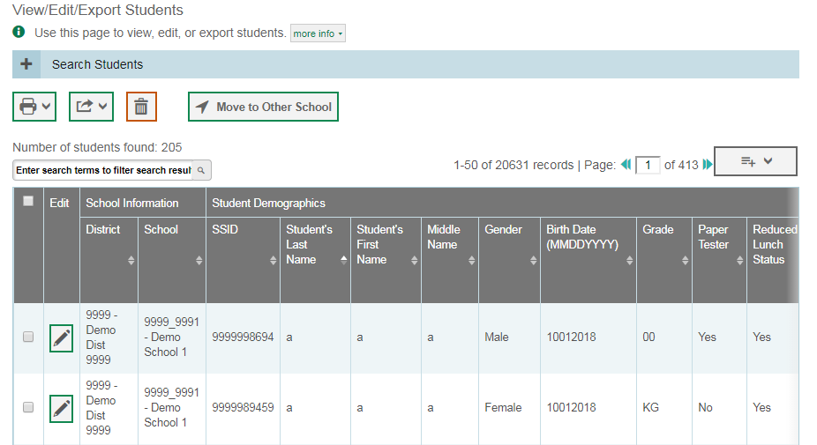
View/Edit/Export Students Results
Notes:
When you click View Results, TIDE will display all the students satisfying the search criteria. You can edit a student’s information, including test settings and accommodations, by clicking the green pencil icon.
Print or export student information or delete students from TIDE by selecting the desired students and clicking the Print, Export, or Delete button above the search results.
To make the search form re-appear and search for additional students, click the plus sign in the Search Students panel, which appears as a blue bar. For more detailed information on managing students, see your TIDE User Guide.

Slide 10
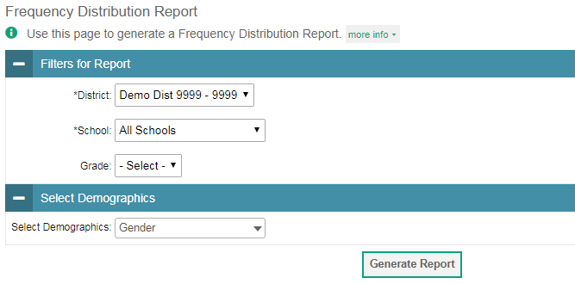
Frequency Distribution Report
Notes:
A frequency-distribution report pulls demographic and enrollment information based on selected criteria.
To generate a report from the Frequency Distribution Report page, select a district and school from the drop-down lists (if available). Mark checkboxes in the Select Demographics panel to filter the report for additional demographics (and accommodations if available in your state), as desired.
Click Generate Report to display a frequency distribution report using the selected criteria.

Slide 11
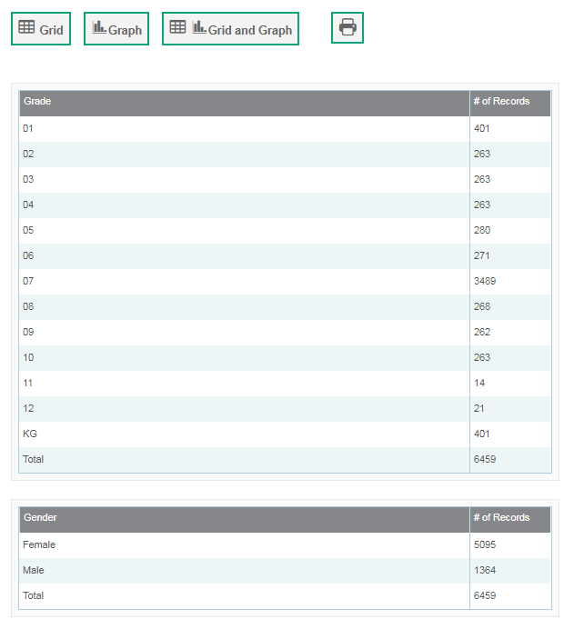
Frequency Distribution Report (Continued)
Notes:
TIDE will display the frequency-distribution report in grid format. This example shows a report by grade and gender.
To display the report in tabular format, click Grid.
To display the report in graphical format, click Graph.
To display the report in both tabular and graphical format, click Grid & Graph.
To download the report as a PDF, click the Printer button.

Slide 12
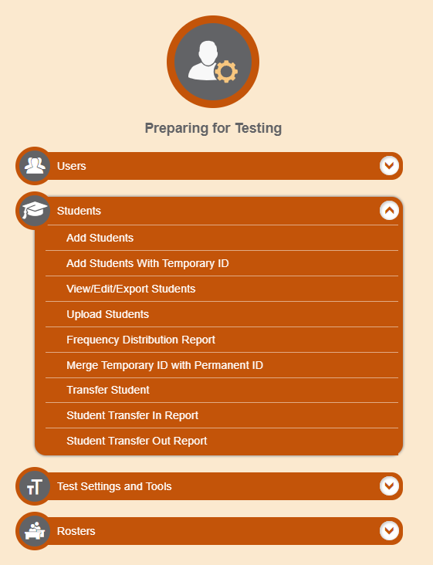
Transfer Student
Notes:
Transfer Student allows you to move students between schools and districts.
From the Students task menu on the TIDE dashboard, select Transfer Student. The Transfer Student page appears. In the SSID field, enter the student’s unique identifier. Specify values for any two of the following three fields:
In the First Name field, enter the student’s first name as it is registered in TIDE.
In the Last Name field, enter the student’s last name as it is registered in TIDE.
In the Date of Birth field, enter the student’s date of birth as it is registered in TIDE.
Select Search. The search results grid appears, displaying the student’s information. Verify the student’s information. Next, mark the checkbox for the student and select Move to Another School above the search results.

Slide 13
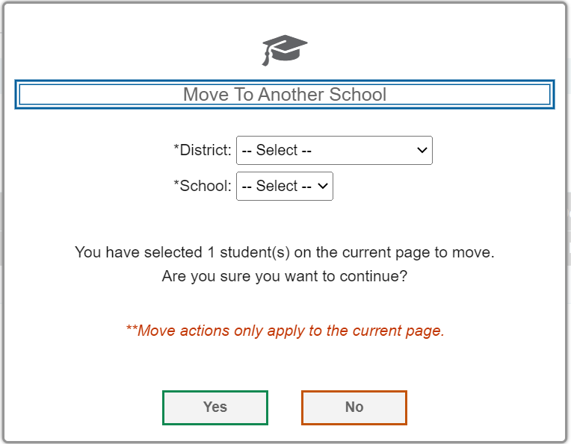
Transfer Student (Continued)
Notes:
A pop-up window appears for moving the student. From the District drop-down list (if available), select the district to which you want to move the student.
From the School drop-down list, select the school to which you want to move the student.
Select Yes. After TIDE moves the student, a confirmation message appears. Select Continue.

Slide 14
Student Transfer In Report
Notes:
District-level users can view reports of students who have transferred into their organization.
From the Students task menu on the TIDE dashboard, select Student Transfer In Report. The Student Transfer In Report page appears. Enter search criteria and select Search.
The report appears, displaying students matching the search criteria.

Slide 15
Student Transfer Out Report
Notes:
District-level users can view reports of students who have transferred out of their organization.
From the Students task menu on the TIDE dashboard, select Student Transfer Out Report. The Student Transfer Out Report page appears. Enter search criteria and select Search.
The report appears, displaying students matching the search criteria.

Slide 16
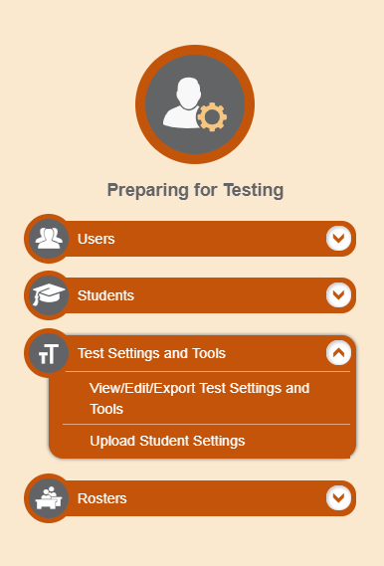
Test Settings and Tools
Notes:
TIDE keeps track of student test settings, such as font size and students taking the paper-pencil test. The Test Settings and Tools task menu allows you to view, edit, export or upload test settings and tools.

Slide 17
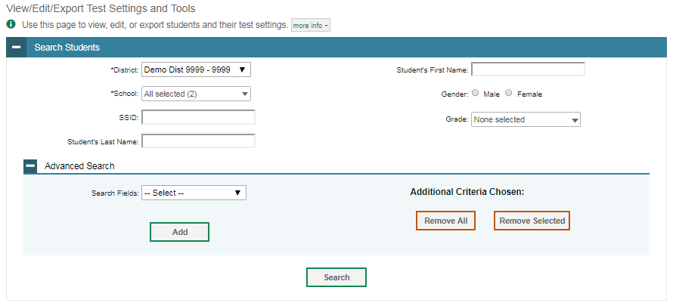
View/Edit/Export Test Settings and Tools
Notes:
The View/Edit/Export Test Settings and Tools page includes a form for setting selection criteria to retrieve a student’s test settings and tools. Required criteria, such as the district and school in this example, are marked with asterisks. Other criteria are optional, such as the student ID and the student’s first or last name. Your state’s TIDE may have other fields by which you can retrieve students’ test criteria.
You can further refine your criteria by entering additional demographic information or test settings in the Advanced Search panel, if it is available.
The students you can retrieve on this page are limited by your role’s scope. For example, if you are a district-level user, you can retrieve settings for those students enrolled within your district. If you are a school-level user, you can only retrieve settings for those students enrolled within your school.
Click Search to continue.

Slide 18
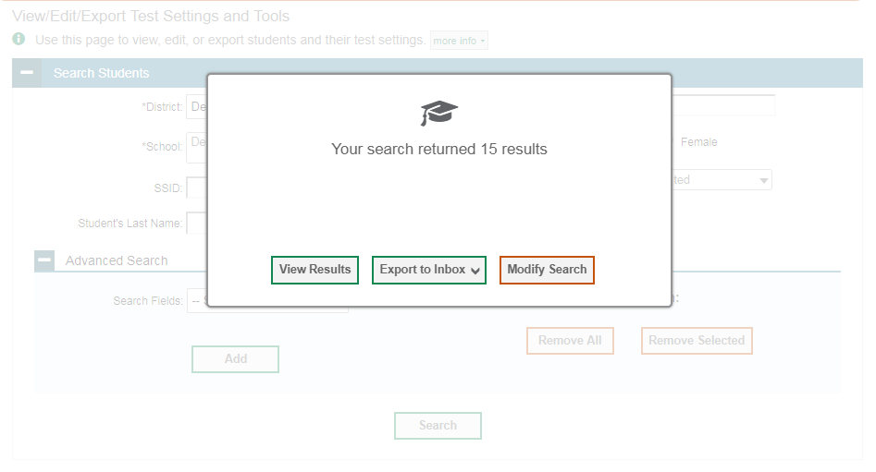
View/Edit/Export Test Settings and Tools (Continued)
Notes:
After you click Search, you’ll see a message asking whether you would like to view the results of your search, export the list of student test settings to your inbox, or modify your search criteria and try again. If you choose to export the results to your inbox, you will receive an email when the file is ready for you to download.

Slide 19
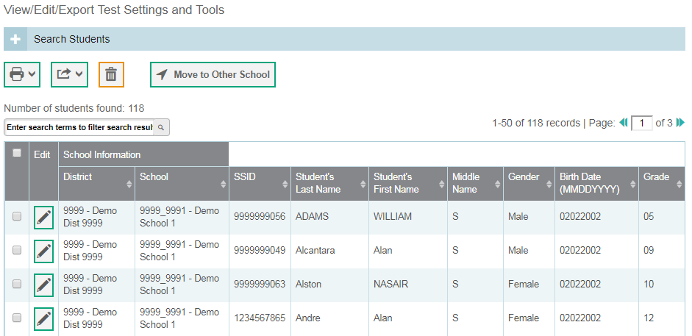
View/Edit/Export Test Settings and Tools Results
Notes:
When you click View Results, TIDE will display all the students satisfying the search criteria. You can edit a student’s test settings and accommodations, by clicking the pencil icon.
To make the search form re-appear and search for additional students, click the plus sign in the Search Students panel, which appears as a blue bar. For more detailed information on managing student test settings and tools, see your TIDE User Guide.

Slide 20
View/Edit/Export Test Settings and Tools Results (Continued)
Notes:
Print or export student information or delete students from TIDE by selecting the desired students and clicking the Print, Export, or Delete button above the search results. Only authorized users can delete students.
Authorized users can also move selected students from one school to another by clicking Move to Other School.

Slide 21
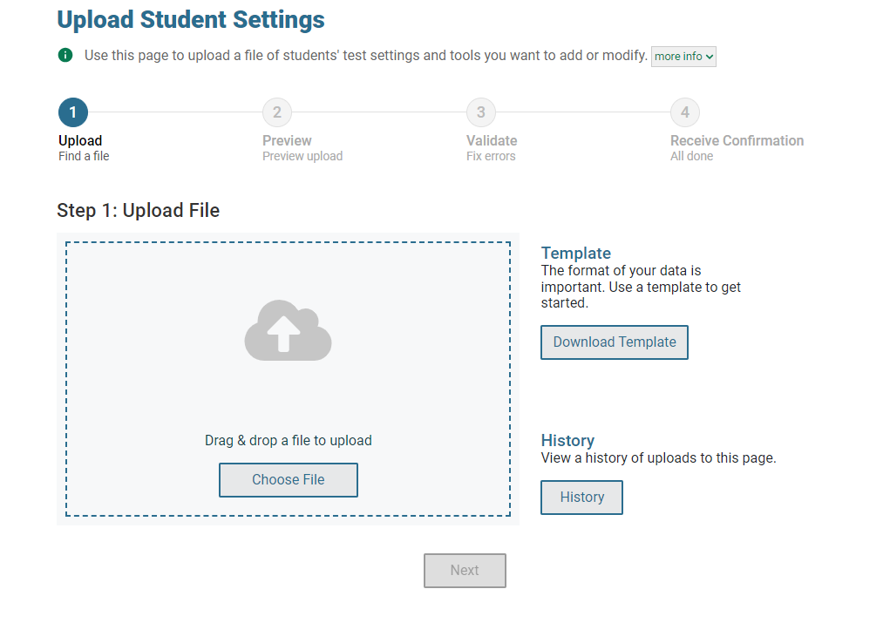
Upload Student Settings
2
3
Notes:
Users with certain roles may also edit test settings and tools in TIDE by using the Upload Student Settings page to compose an upload file in Excel or CSV format and then upload that file. This method is convenient if, for example, you have many students who need domain exemptions, and you don’t want to input them manually by searching for each student. Note that students who require a domain exemption must have that domain exemption recorded in TIDE prior to testing. If no domain exemption appears in TIDE, then all domains will be scored for the student, even if no questions are answered.
The easiest way to compose an upload file is to download an available template, which you can do by clicking Download Templates and selecting either Excel or CSV. CAI recommends that most users select Excel format.
Open the template using Excel or another program and enter the information for each student you wish to add. Enter the information into each column from left to right, using one row per student, per test setting. Save the file when you are finished. Detailed instructions for composing an upload file can be found in the TIDE User Guide. To see a list of files you have previously uploaded, click the blue plus sign to expand the Upload History panel.
When your file is ready to upload, return to TIDE, click Choose File, and select the file you just saved.
Click Next to upload the file. A file preview page will appear, allowing you to verify that you are uploading the correct file. If the preview is correct, click Next to continue.

Slide 22
Upload Student Settings (Continued)
Notes:
TIDE will validate the file and display any errors or warnings according to the legend on the page. Click the orange error icons and blue warning icons in the validation results to view the reason a field is invalid. If a record contains an error, that record will not be included in the upload. If a record contains a warning, that record will be uploaded, but the field with the warning will be invalid.
To complete the upload, click Continue with Upload.
To upload a different file, click Upload Revised File.
If your file contains a large number of records, TIDE will process it offline and send you a confirmation e-mail when complete. While TIDE is validating the file, do not press Cancel, as TIDE may have already started processing some of the records.
To view a PDF file listing the validation results for the upload file, click Download Validation Report.
When the upload is complete, a confirmation page will appear with a message that summarizes how many records were committed and how many were excluded.

Slide 23
Thank You!
For additional information, consult your state portal, which contains:
Important announcements
TIDE User Guide
For further assistance, please consult your state’s Help Desk.
Notes:
Thank you for viewing this training module. For additional information, refer to your TIDE User Guide located on your state’s portal. You may also wish to view additional resources available on the portal.
If you have general questions or need further information, please consult your state’s Help Desk for assistance.

