Slide 1
Adding and Editing Users
TIDE Training Module #2
Copyright © 2023 Cambium Assessment, Inc. All rights reserved.
Notes:
Welcome to the online training module for Adding and Editing Users in TIDE. In this training module we will walk through the process for adding users, determining their roles and permissions, and editing existing users.

Slide 2
TIDE Training Modules
Activating Your Account and Navigating Through TIDE
Adding and Editing Users
Adding and Editing Students and Student Test Settings
Adding Students with a Temporary ID (for Screener only)
Managing Rosters
Appeals Process
Printing Test Tickets and Pre-ID Labels
Ordering Paper, Large Print, and Braille Tests and Tracking Shipments*
Entering Reason Not Tested Codes (for Summative administration only)
*Only applicable to states that elect to use the paper ordering module in TIDE
Notes:
The “Adding and Editing Users” module is second in a series of online training modules on the TIDE system and its features. Visit the other training modules to learn about other features in TIDE and check out the TIDE User Guide on your state’s portal for additional information about features in your state’s version of TIDE.
Please note that your state’s version of TIDE may be different from the images shown in this presentation.

Slide 3
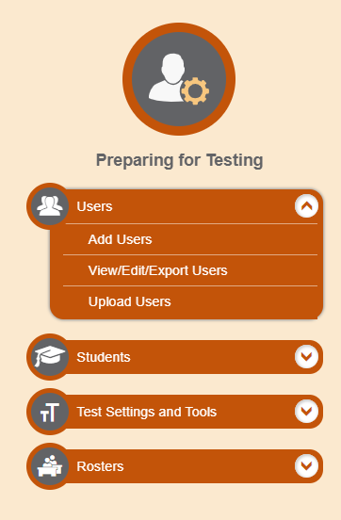
Users
Notes:
Before testing begins, and throughout the school year, TIDE is used to manage user accounts for TIDE itself, the TA Interface, the Reporting System, and other systems.
Every TIDE account has an assigned role, and that role has certain permissions. Permissions define what tasks you can perform in TIDE. Your role also limits the scope of your data access. For example, a district-level user can work with data pertaining to that district, and a school-level user can work with data pertaining to that school. For detailed information on user roles and permissions, consult your TIDE User Guide.
Depending on your role, the Users task menu allows you to add users; view, edit, or export users; and upload users from an external file.

Slide 4
Add Users
Notes:
You can manually add new users from the Add Users page. Enter the email address for the user you want to add. Click + Add user or add roles to user with this email. If the email exists, then options will be available to add multiple roles for the user.
The new user’s email address will serve as their username when logging in to any system.

Slide 5
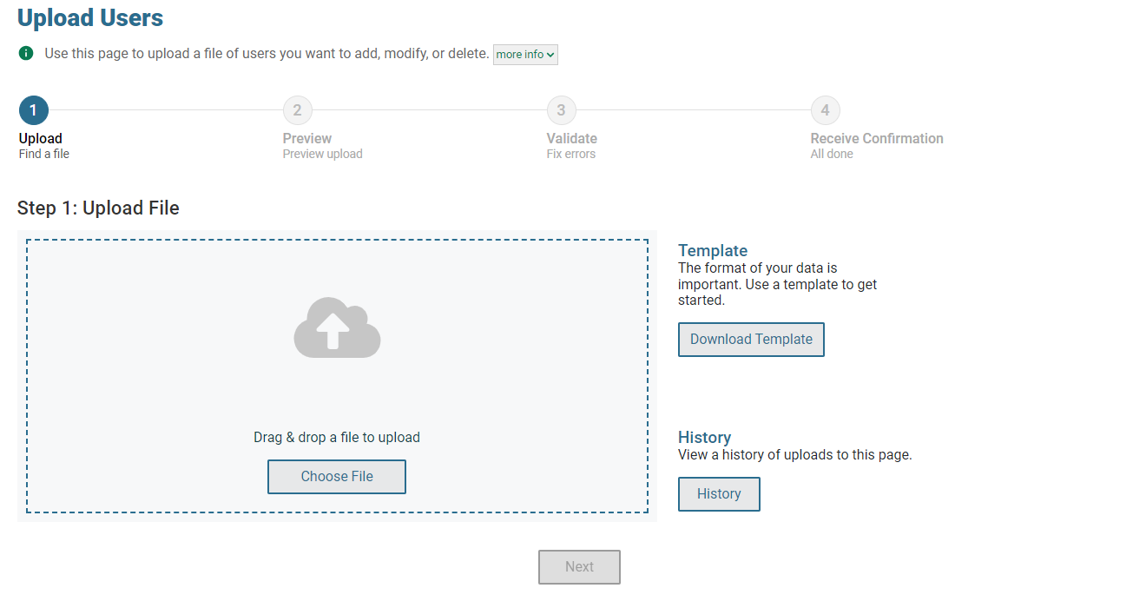
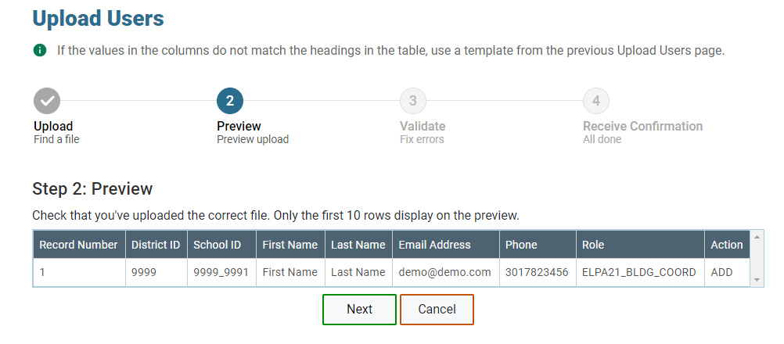
Upload Users
Notes:
A second way to add new users to TIDE is to use the Upload Users page to compose an upload file in Excel or CSV format and then upload that file. This method is easiest if you have many new users and you don’t want to add them one at a time from the Add User page.
The easiest way to compose an upload file is to download an available template by clicking Download Templates. You may also access files that you have previously uploaded by clicking the blue plus sign to expand the Upload History panel.
Open the template, enter information for the users you wish to add using Excel or another program, and save the file in Excel or CSV format. Detailed instructions for composing an upload file can be found in the TIDE User Guide.
Once you return to TIDE, click Choose File, and select the file you just saved.
Click Next to upload the file. A file preview page will appear, allowing you to verify you uploaded the correct file. If the preview is correct, click Next to continue.

Slide 6
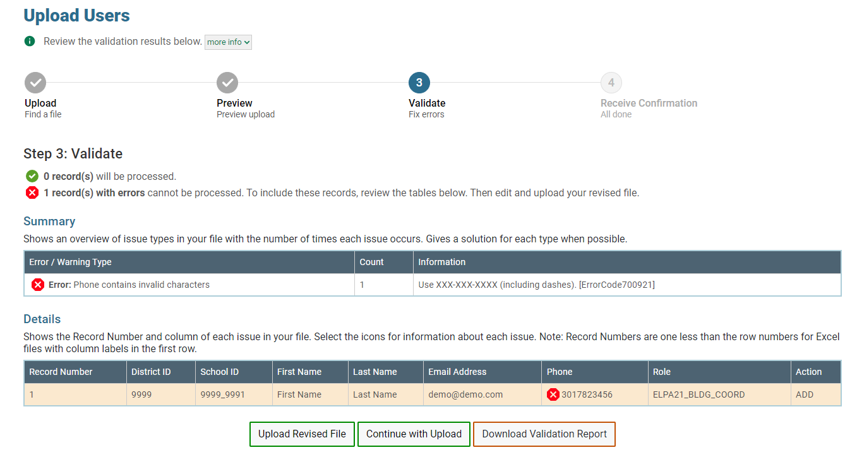
Upload Users
Notes:
Next, TIDE will validate the file and display any errors or warnings according to the legend on the page. Click the orange error icons and blue warning icons in the validation results to view the reason a field is invalid. If a record contains an error, that record will not be included in the upload. If a record contains a warning, that record will be uploaded, but the field with the warning will be invalid.
To complete the upload, click Continue with Upload.
To upload a different file, click Upload Revised File.
If your file contains a large number of records, TIDE will process it offline and send you a confirmation email when complete. While TIDE is validating the file, do not press Cancel, as TIDE may have already started processing some of the records.
To view a PDF file listing the validation results for the upload file, click Download Validation Report.
When the upload is complete, a confirmation page will appear with a message that summarizes how many records were committed and how many were excluded.

Slide 7
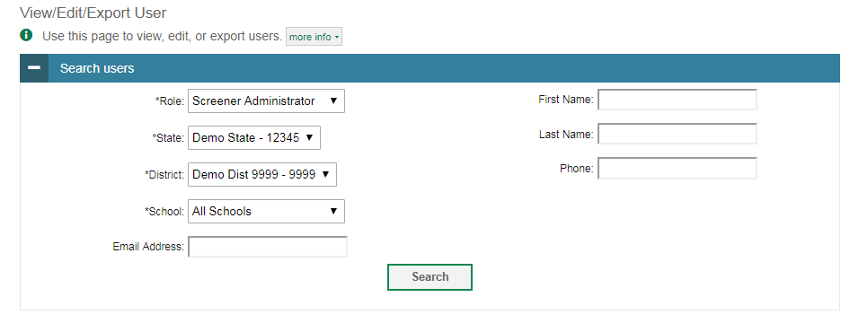
View/Edit/Export Users (Continued)
Notes:
Users with certain roles may use the View/Edit/Export Users page to retrieve users who match search criteria. The user’s role, district, and school are required criteria. Other criteria are optional, such as the first or last name. Click Search to continue. The search panel will automatically collapse, and your search results will appear below.

Slide 8
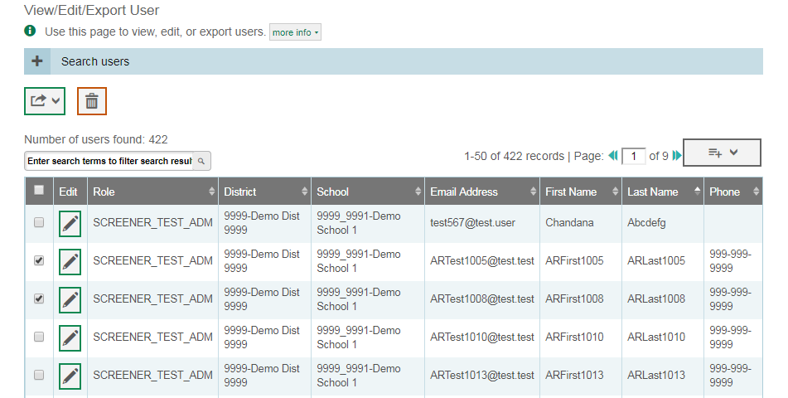
View/Edit/Export Users (Continued)
Notes:
After clicking Search, TIDE will display all the users satisfying the search criteria. If your user role permits, you can edit a user’s information by clicking the pencil icon. Another page will appear for you to edit and save information.
To export user information, mark the checkboxes next to the users you wish to export and click the export button above the search results. A pop-up window will appear with the option to export to the Inbox in either Excel or CSV format.
To delete users from TIDE, mark the checkboxes next to the users you wish to delete and click the trash can button above the search results.
To make the search form re-appear and search for additional users, click the plus sign in the Search Users panel, which appears as a blue bar. For more detailed information on managing users, see your TIDE User Guide.

Slide 9
Thank You!
For additional information, consult your state portal, which contains:
Important announcements
TIDE User Guide
For further assistance, please consult your state’s Help Desk.
Notes:
Thank you for viewing this training module. For additional information, refer to your TIDE User Guide located on your state’s portal. You may also wish to view additional resources available on the portal.
If you have general questions or need further information, please consult your state’s Help Desk for assistance.

