Slide 1
Data Entry Interface (DEI)
For Paper and Braille Test Administrations
Copyright © 2023 Cambium Assessment, Inc. All rights reserved.
Notes:
Welcome. In this training module, we will discuss how to use the Data Entry Interface (DEI) to enter student responses on paper-based and braille tests.
Please note: The standard administration of the ELPA21 assessment is via the online format for all students in all grade bands. A lack of technology skills is not a reason to use a paper test. If the student does not possess the necessary technology skills, then the Test Administrator (TA) will operate the technology for the student. In addition, some states have specific restrictions on who can be administered a paper test. Please refer to your Directions for Administration for details and step-by-step guidance unique to your assessment.
This module covers information TAs should be aware of before using the Data Entry Interface, known as the DEI. For more detailed information on using the DEI, refer to the Data Entry Interface User Guide available on your state’s portal.

Slide 2
Objectives
After viewing this presentation, you should be able to:
Understand what the Data Entry Interface is and how to access it
Enter student responses into the DEI
Use the different features available in the DEI
Notes:
After viewing this presentation, you should be able to:
Understand what the Data Entry Interface is and how to access it
Enter student responses into the DEI and
Use the different features available in the DEI

Slide 3
Using the DEI
The DEI can be used for both paper and braille test administration:
To record spoken responses to the Speaking test
To enter and transcribe student responses for all other test items
Notes:
The DEI is used to enter student responses for students taking the test in paper and braille forms. The DEI is also used to record responses to the speaking test for students who take the test using paper and braille forms.

Slide 4
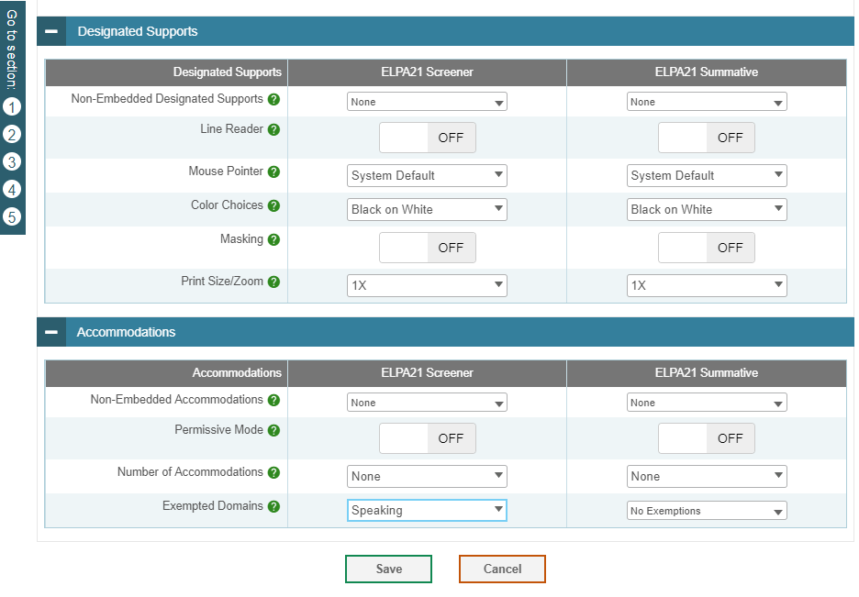
Confirming Student Settings in TIDE
TIDE is the “home” for all student data and accommodations.
Before a TA can enter data for a student into the DEI, that student’s record should be checked in TIDE to ensure that the correct flag has been set for a paper or braille form.
Domain exemptions must be marked in TIDE prior to testing.
Notes:
For the TA to enter data for a student in the DEI, the student’s record in TIDE needs to be updated to allow for a paper or braille form. TIDE is the “home” for all student data and accommodations. That student’s record should be checked in TIDE to ensure that the correct flag has been set for a paper or braille form. The TIDE User Guide has more information about how to do this.
Domain exemptions must be entered in TIDE prior to the TA entering the student responses in the DEI. If a domain exemption is entered in TIDE prior to the start of data entry in the DEI for a student, and no responses to items in the exempt domain are entered in the DEI, only items in the non-exempt domains will be used to determine the student’s test score.
However, if a student is exempt from a domain but responses to any items in the domain are entered in the DEI, the domain will be scored as though the student was not exempt. Contact your state administrator for clarification on how to determine and record domain exemptions in TIDE in your state.

Slide 5
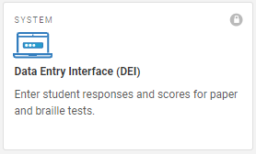
Accessing the Data Entry Interface
To access the DEI, navigate to the Teachers and Test Administrators page on the portal and select the Data Entry Interface icon.
Notes:
For paper and braille testing, the TA should log into the system in preparation for administering the speaking test items.
To access the DEI, navigate to the Teachers and Test Administrators page on the portal and select the “Data Entry Interface” icon.

Slide 6
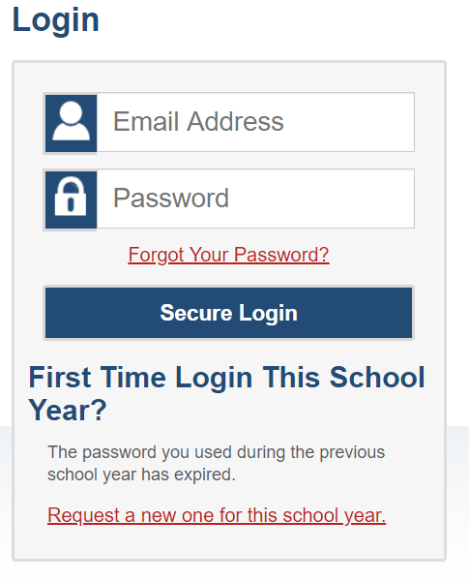
Accessing the Data Entry Interface (Continued)
Log in with your username and password.
Notes:
Log in with your username and password. This is the same username and password you use to access all CAI systems including TIDE and the Test Administrator Interface.

Slide 7
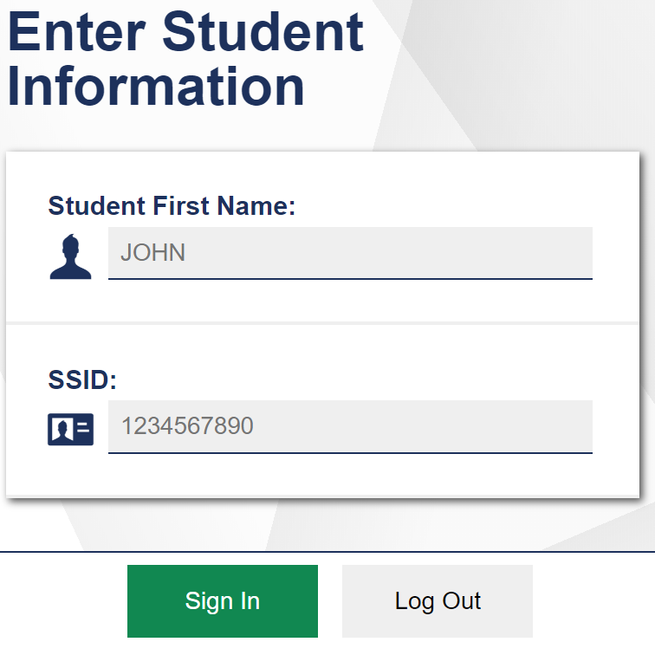
Accessing the Data Entry Interface (Continued)
You will be prompted to enter information for the student you are testing.
Enter the student’s first name and student ID (or temporary ID), and then click Sign In.
Notes:
After logging in to the DEI, you will be prompted to enter information for the student you are testing. Enter the student’s first name and student ID number. Please note that the student’s first name and ID must match what is pre-identified in TIDE. If the student does not have a permanent student ID yet, then you should enter the temporary ID listed for the student in TIDE. For information about registering students in TIDE, please consult your TIDE User Guide.
When you have entered the information, click Sign In.

Slide 8
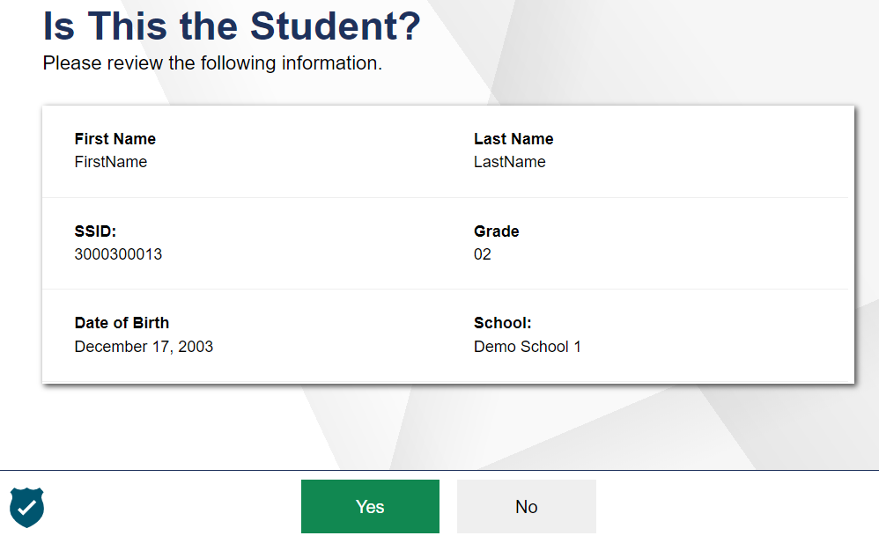
Accessing the Data Entry Interface (Continued)
Verify that the student’s demographic information is correct.
If all of the student’s information is correct, click YES. If any information is incorrect, click NO and then contact your test coordinator.
Notes:
Next, you will be prompted to verify that the student’s demographic information is correct. Please be sure to review every field. If all of the student’s information is correct, click YES. If any information is incorrect, click NO, and contact your test coordinator.

Slide 9
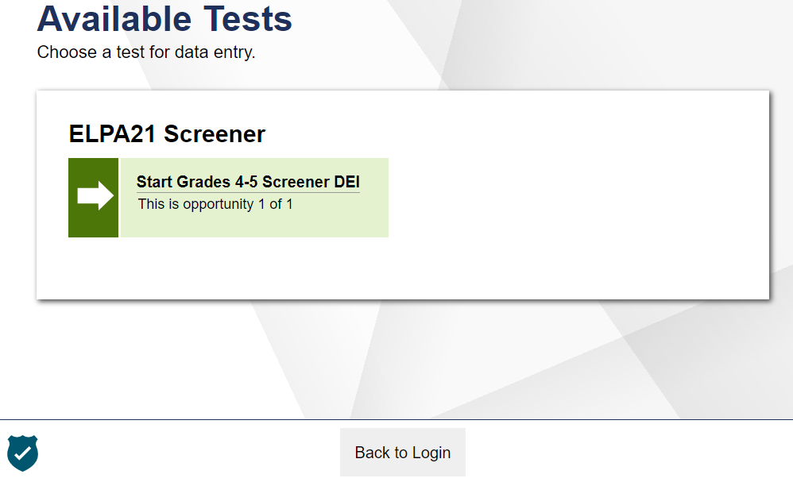
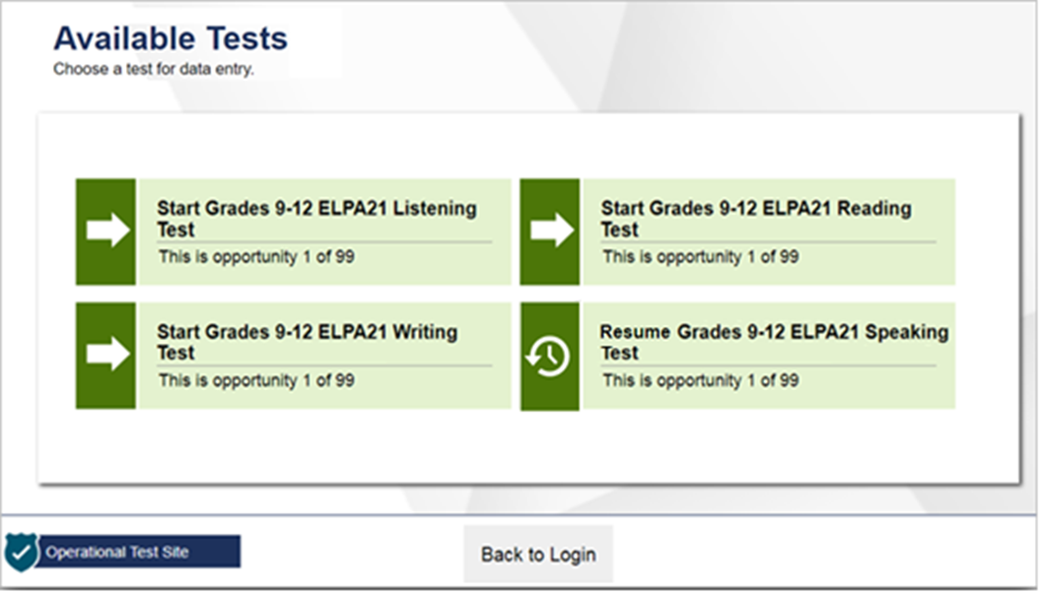
Test Selection
Screener
Summative
Notes:
After verifying the student’s information, the Available Tests screen will appear. Please note three things about this page:
First, the page lists the tests available for the student based on the student’s grade level. Please verify that the appropriate test is listed for the student. If the test for this student is missing or incorrect, please contact your test coordinator.
Second, the icons on this page signal the test’s status. And indicates that the test has not been started and no data has been entered. A clock face indicates that the test has been started, but still needs to be reviewed and submitted.
Finally, please note that the screener includes all domains within a single test. The Summative test lists each domain as a separate test.

Slide 10
Audio Playback Check
Notes:
After selecting a test requiring audio, you will see the Audio Playback Check. Click the speaker button and indicate whether the sound is audible by choosing either the I heard the sound or I did not hear the sound button.
If you click, I did not hear the sound, you will receive a message advising you to adjust your device’s volume settings and try again. Make sure the audio is not muted on the computer and the headset is properly connected.

Slide 11
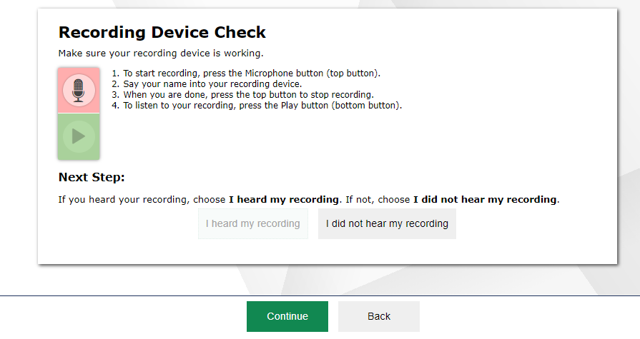
Recording Device Check
Start/Stop Recording
Start/Stop Playback
Notes:
You will also be asked to verify that your microphone is functioning.
To continue, click the microphone icon on this screen. Students should say their name into the microphone and then click the top button again to stop recording. You can do this for students.
After stopping recording, press the bottom button to play back the recording.
If you clearly hear the recording, click I heard my recording to proceed to the test.
If the audio is not clear, click I did not hear my recording and then click Try Again to record an audio sample again. You can click Select New Recording Device to try recording using a different attached audio device, or click Logout to leave the test and adjust the microphone settings.

Slide 12
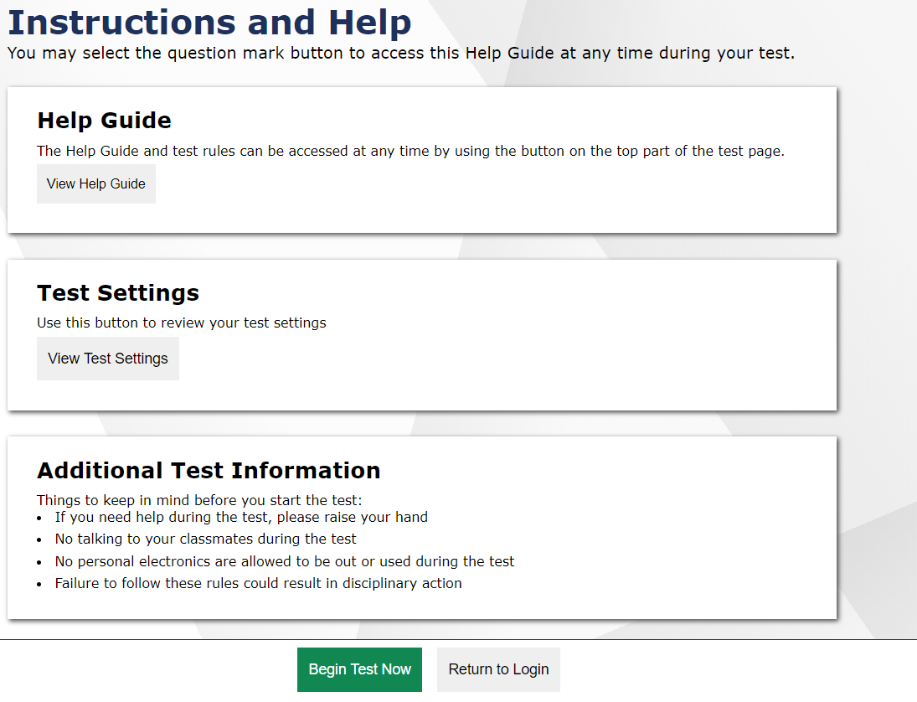
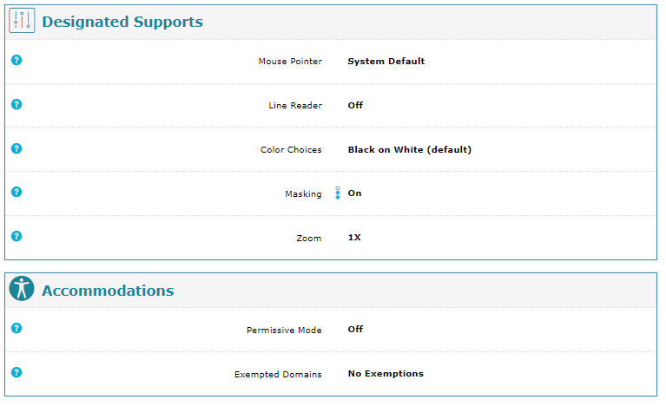
Instructions and Help
Notes:
Before beginning data entry, the Instructions and Help page will appear.
The Help Guide will bring up content that explains the Test Rules and gives an overview of the Data Entry Interface.
The Test Settings will bring up the Designated Supports and Accommodations assigned to the student.
Some important reminders are listed under Additional Test Information.
Selecting the Begin Test Now button will take you to the first question of the test.
You may select the question mark button to access this Help Guide at any time during the test.

Slide 13
Screener Participation Questions
The following two slides are specific to the administration of the Screener. If you are administering the Summative assessment, please skip to slide 18.
Notes:
The following two slides are specific to the administration of the Screener. If you are administering the Summative assessment, please skip to slide 18.

Slide 14
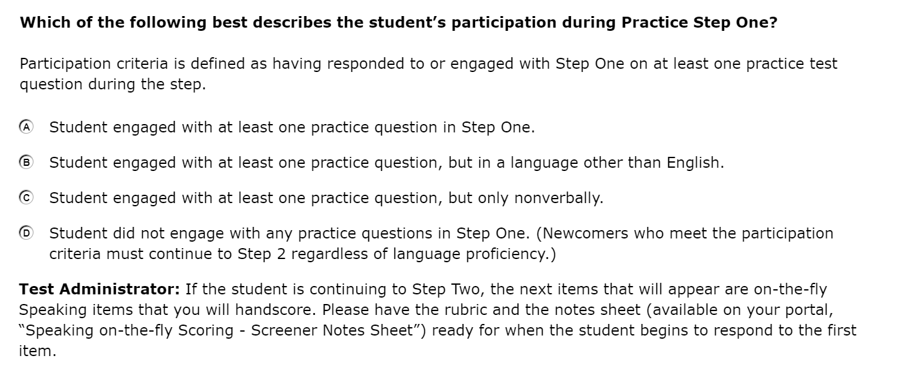
Administering the Screener
Practice Step One
Notes:
The Screener is divided into three steps. The first part, Practice Step One, consists entirely of unscored items, which are marked “PRACTICE” and are intended to help students get accustomed to the format of the test. During administration of the screener, the TA should be seated adjacent to the student at the student’s computer. No other students should be in the testing room, as this is a secure testing environment.
At the end of Practice Step One, the TA must log into the DEI. The TA will be presented with a screen with four choices.
Student engaged with at least one practice question in Step One.
Student engaged with at least one practice question in Step One, but in a language other than English.
Student engaged with at least one practice question in Step One, but only nonverbally.
Student did not engage with any practice questions in Step One.
The TA must select one of these choices.

Slide 15
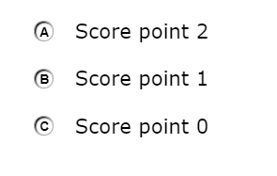
Administering and Scoring Speaking Items
Notes:
There are four speaking items students must respond to in Step 2 of the screener. The TA must record student responses into the DEI as the student responds. The TA will click the microphone icon to start and stop recording a student’s response. The TA will click the play icon to start or stop a playback of a student’s response.
Once the TA finishes recording the four speaking items in the DEI, they will score the responses by selecting the score on the appropriate radio button in the DEI for each question.

Slide 16
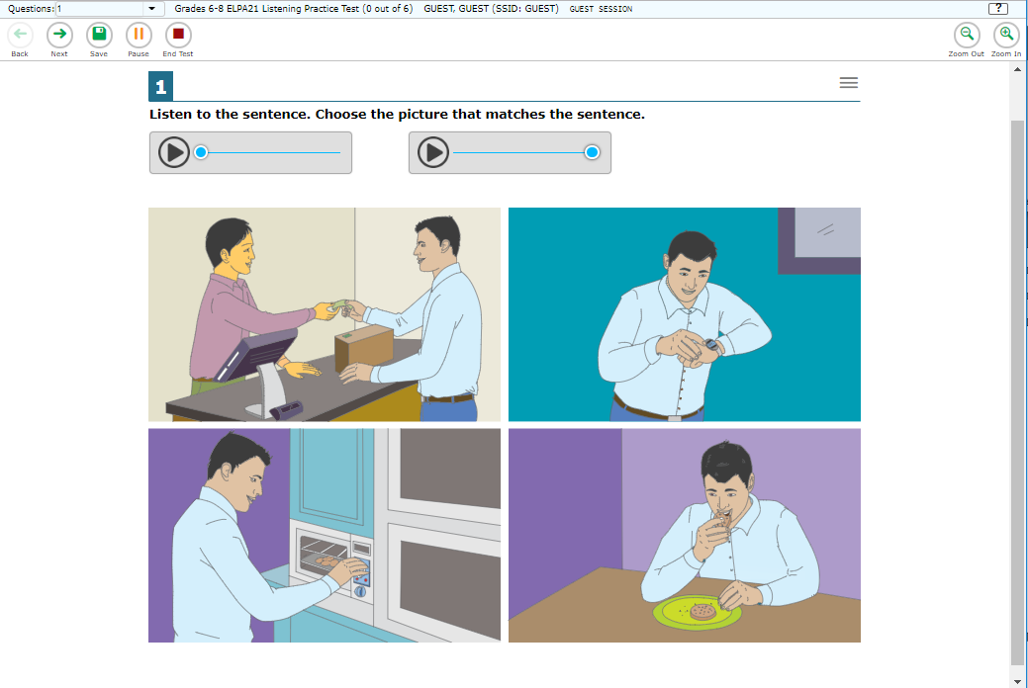
Entering Data into the DEI
Notes:
Similar to the test booklet, the item questions are presented in bold text. This screenshot shows you an example of what a listening item looks like.
The data entry page will display one item at a time within a task. You can use the green arrow buttons labeled Back and Next in the upper-left corner of the screen to move between the items of a task. You can also jump directly to a specific task using the Items drop-down menu.

Slide 17
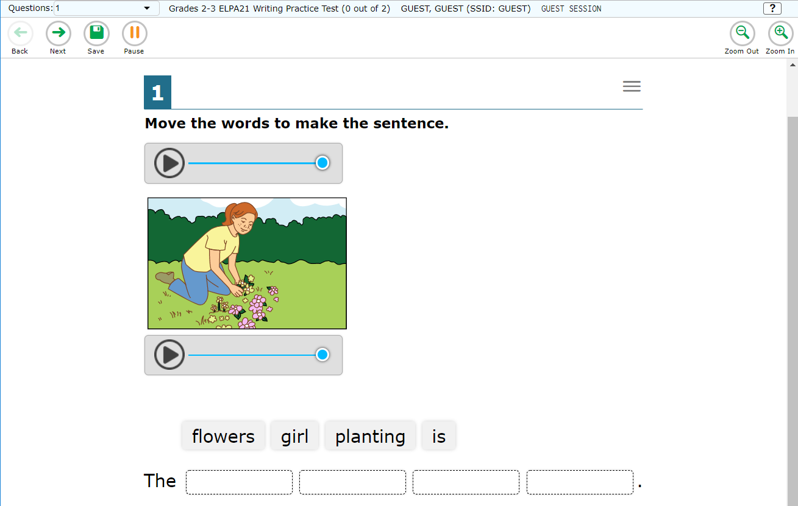
Entering Data into the DEI (Continued)
Notes:
The Save button can be used to save a response but is not necessary to use since responses are automatically saved upon selection.
The Pause button is used to pause the data entry session without submitting the test, so you can continue entering data at a later time.
You can use the Zoom Out and Zoom In buttons at the top right of the screen to magnify text and images.
Please note that the DEI is designed to look similar to the online test students see when testing online, therefore students may have additional tools and accommodations available. These tools and accommodations are not necessary for TAs to use when using the DEI.

Slide 18
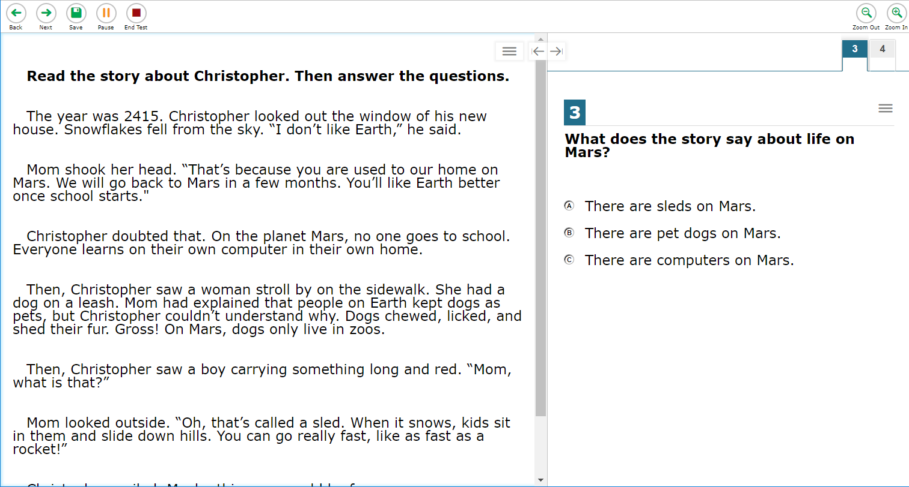
Entering Student Response Data: Paper Administration
Notes:
When entering the paper administration data for the multiple choice Listening, Reading, and Writing sections, students mark their responses in their test booklet. At the conclusion of the testing session, the TA will input the student’s responses into the DEI.
For the Writing constructed response and word and sentence builder section, the test administrator will copy the student’s response from the test booklet into the DEI for scoring. For the word & sentence builder items, the TA will drag and drop the response tiles to match the student’s response exactly.
For the constructed-response items, the TA will use the DEI to transcribe the student’s written responses verbatim.
For the Speaking section, the TA will record the student’s spoken responses directly into the DEI during testing.

Slide 19
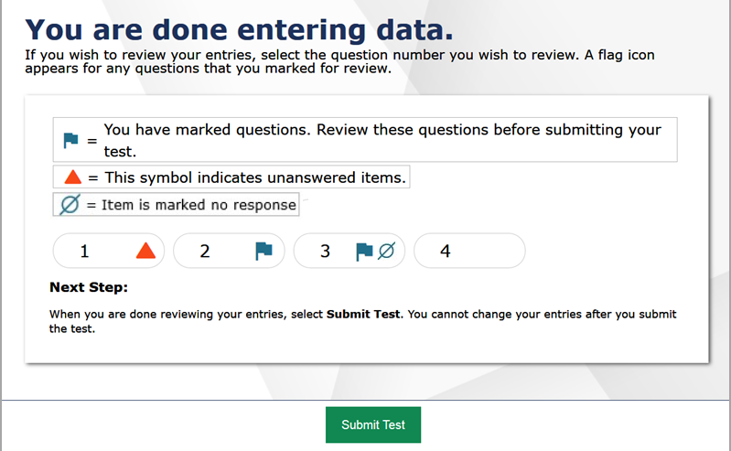
Entering Student Response Data: Paper Administration
Notes:
After the student responds to all questions in Step 2, the TA will input the student’s responses for questions in Step 2 into the DEI. Click Next after all Step 2 responses have been entered. If the test engine determines the students test complete, the TA will see the You are done entering data page and submit the test. If the test engine does not determine the test as complete, the DEI will move immediately onto Step 3 questions. If a student proceeds to Step 3, the TA will continue using the DFA to administer the student's test.

Slide 20
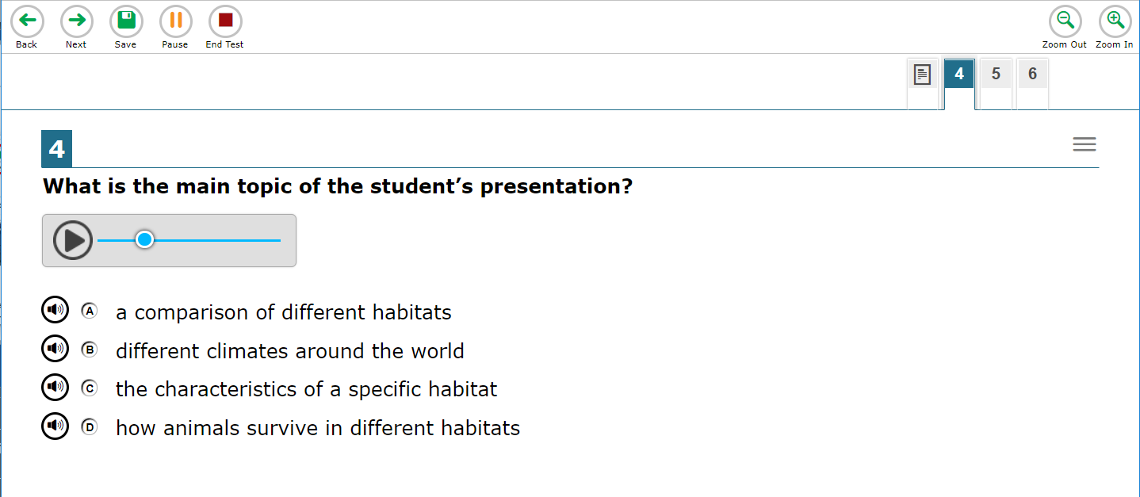
Entering Student Response Data: Braille Administration
Notes:
When entering the braille administration data for the multiple choice Listening, Reading, and Writing sections, the test administrator should mark the student’s indicated responses in the DFA. At the conclusion of the testing session they will enter the student’s responses into the DEI.
For the Writing section, if the student is able to use a braille writing device to respond, the TA will administer the Writing test items labeled “DEVICE.” After the test is complete, the TA will print the responses, and then transcribe the printed responses verbatim into the DEI.
If the student does not have a braille writing device or is not yet proficient with one, the TA will administer the Writing test items labeled “ACCESSIBLE.” Those responses will be scribed by the TA. Then the TA will type the scribed responses verbatim into the DEI.
When entering braille Administration data for the Speaking section, the TA will record the student’s spoken responses directly into the DEI during testing.

Slide 21
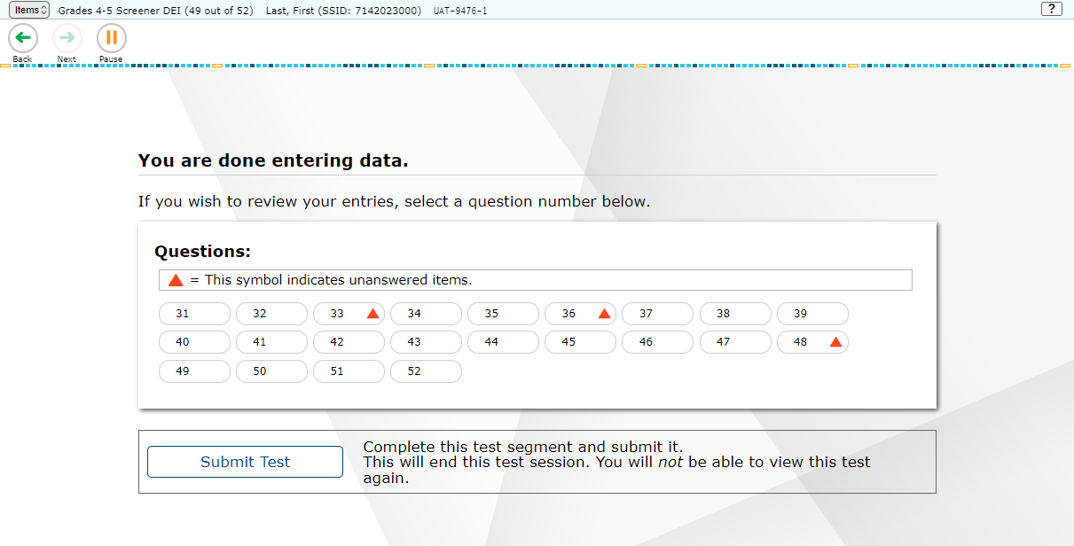
Done Entering Data
Notes:
After completing data entry, be sure to review all entered data. Follow the instructions provided in the Directions for Administration Manual.
When you have checked all responses entered and are ready to submit the test, click the Submit Test button. You will be asked to confirm that you would like to submit the test. Click Yes to continue.
If you are not ready to submit answers at this time, click the Pause button to save your work and navigate away from the system. In the process, you will be logged out of this student’s data entry session. If you choose to pause your session, remember to complete data entry and submit the test to be scored.

Slide 22
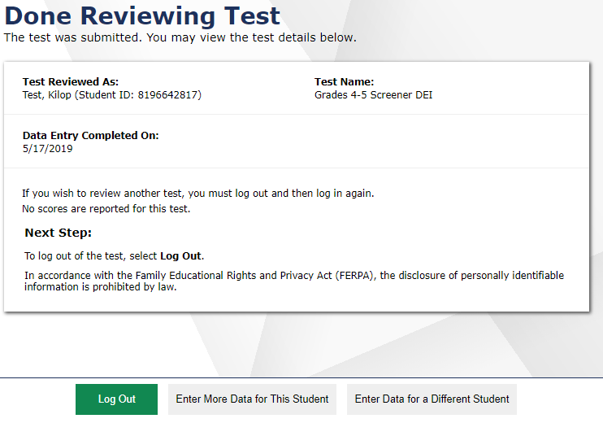
Test Submission
Notes:
The next screen will confirm that the student’s test has been submitted.
From here, you may choose to Log Out or Enter Data for a Different Student.
Note: Although there is an option to “Enter More Data for This Student” on the screen, no additional data can be entered once the ELPA21 Screener test has been submitted. This option is only applicable to the ELPA21 Summative, which has multiple domain tests.

Slide 23
Helpful Hints
If your state allows it, you may skip items that the student has not answered by clicking the Next button.
Questions may appear differently in the DEI from how they appear in the paper test booklets:
Instead of circling a letter, you may need to click on a word or image.
Instead of drawing a line between two objects, you may need to drag and drop one object on top of the other.
Instead of filling in a blank, you may need to choose an answer from a drop-down list.
For a test with domain exemptions to be scored correctly, the exempted domain(s) must be selected in TIDE, and all the questions in this domain must be skipped while the test is being transcribed into the DEI. If any questions are answered in a domain, it will be scored and reported, even if the student is exempted from that domain in TIDE.
Notes:
Here are some helpful hints to assist you with entering student responses in the DEI.
If your state allows it, you may skip items that the student has not answered by clicking the Next button.
Questions may appear differently in the DEI from how they appear in the paper test booklets. It is important to emulate in the DEI how the student responded in the paper test booklet. For example:
Instead of circling a letter, you may need to click on a word or image.
Instead of drawing a line between two objects, you may need to drag and drop one object on top of the other.
Instead of filling in a blank, you may need to choose an answer from a drop-down list.
Finally, for a test with domain exemptions to be scored correctly, note that the exempted domain(s) must be selected in TIDE, and all the questions in this domain must be skipped while the test is being transcribed into the DEI. If any questions are answered in a domain, it will be scored and reported, even if the student is exempted from that domain in TIDE.

Slide 24
Thank You!
For additional information, consult your state portal, which contains:
Important announcements
DEI User Guide
For further assistance, please consult your state’s Help Desk.
Notes:
Thank you for viewing this training module. If you need additional information, please visit your state’s portal, where you can find announcements and copies of the DEI User Guide. Remember to follow the secure Directions for Administration document you received with the student’s paper test while administering these tests for guidance.
For further assistance, please consult your state’s Help Desk.

